Slide 1
MP3 Tag Reader and Editor
Done by
S.YASHVANTH

Slide 2
Objectives
Apply core C Programming concepts to design a real-world MP3 metadata analyzer and editor.
Implement command-line operations to view and edit MP3 tag information
(Title, Artist, Album, Year, Genre, Comment).
Strengthen understanding of Structures, Functions, File I/O, and String Manipulation.
Learn Binary File Handling and Frame Parsing (ID3v2 tags).
Gain exposure to System-Level File Operations and robust error handling.

Slide 3
Foundational Requirements
C Programming Fundamentals → Variables, Functions, Conditionals, Loops.
Structures → Used to store MP3 Tag details (Title, Artist, Album, Year, Genre, Comment).
File Handling (Binary) → Read, write, and modify MP3 tag frames.
String Functions → For comparing and updating frame IDs (e.g., TIT2, TPE1).
Modular Programming → Implemented reusable functions for validation, reading, and editing tags.
Input Validation → Ensures correct file type (.mp3) and valid ID3 headers.

Slide 4
features
View Tags: Display all MP3 tag details such as title, artist, album, year, genre, and comment.
Edit Tags: Update specific tags (Title, Artist, Album, Year, Genre, or Comment) using command-line options.
ID3 Validation: Checks for valid MP3 file format and ID3v2 header before processing.
Frame Reading: Decodes tag frame bytes and extracts text data.
Memory Safety: Uses dynamic allocation and boundary checking.
Error Handling: Handles invalid files, missing tags, and memory errors gracefully.

Slide 5
PROGRAM Flow
Command-Line Interface : * -v → View all tags
* -e → Edit selected tag with new value
File Validation : Checks .mp3 extension and presence of "ID3" header
Tag Viewing (viewing tags): * Reads frame headers (TIT2, TPE1, TALB, TYER, COMM, TCON)
* Displays decoded metadata
Tag Editing (editing tags): * Locates specific frame
* Rewrites with new encoded value while maintaining size limits
Persistent Update: Modified tags are saved directly into the MP3 file

Slide 6
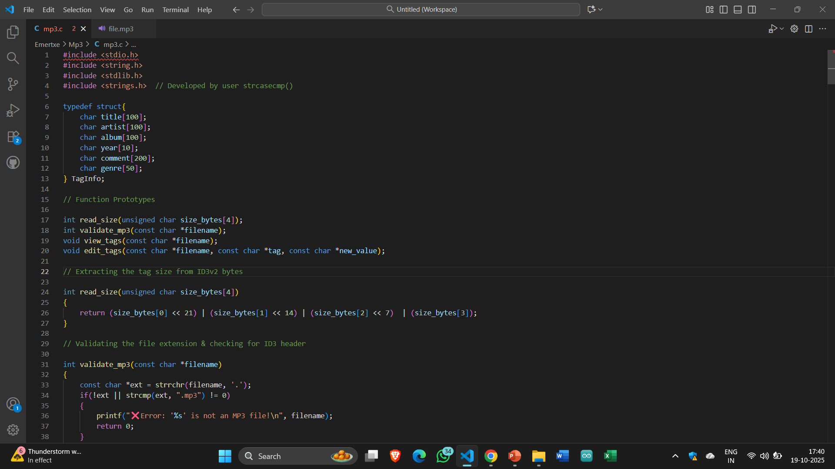
Function Prototypes

Slide 7
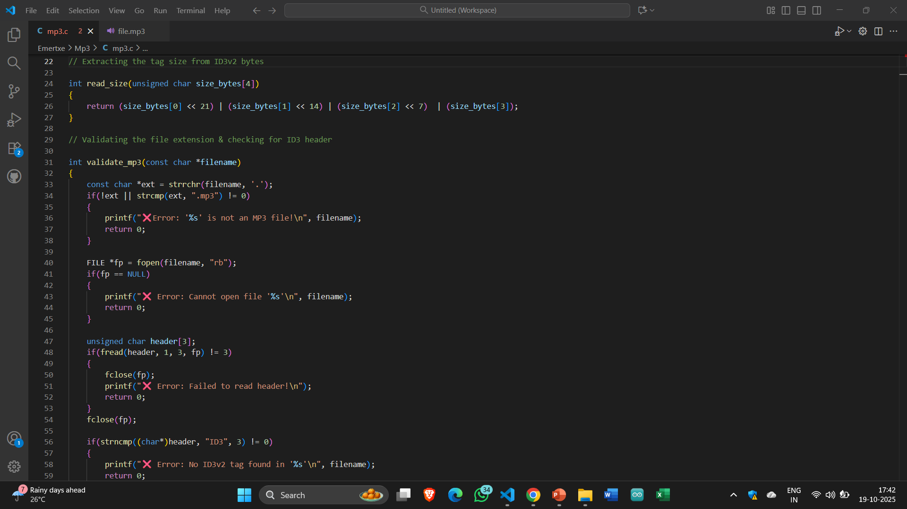
Extracting the tag Size (From id3v2)

Slide 8
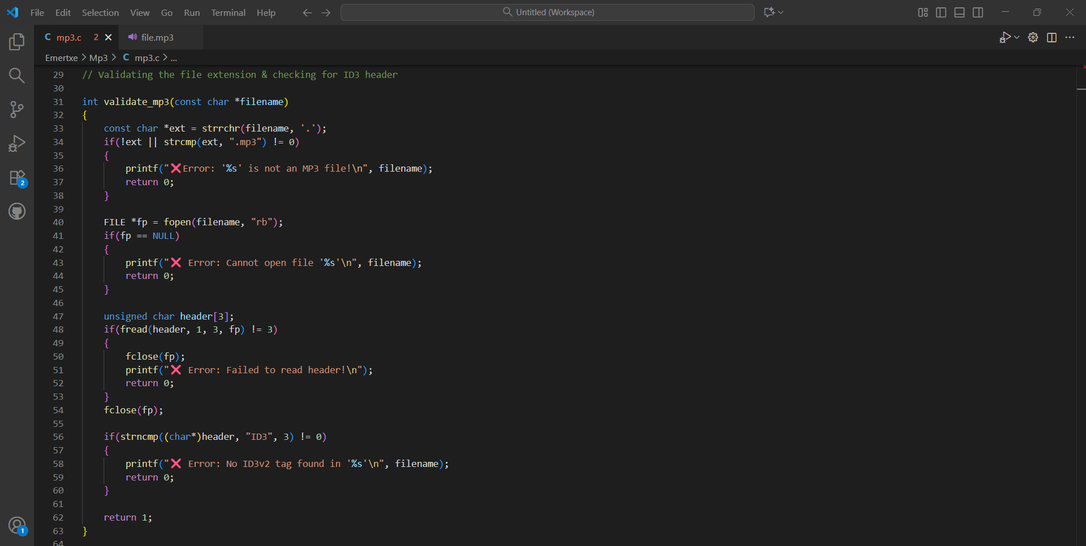
Validating the filename extension

Slide 9
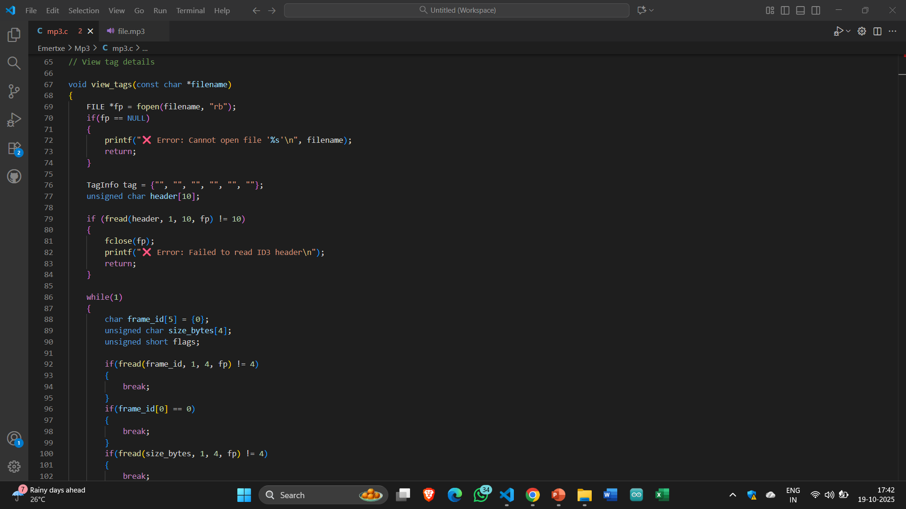
Viewing tag details

Slide 10
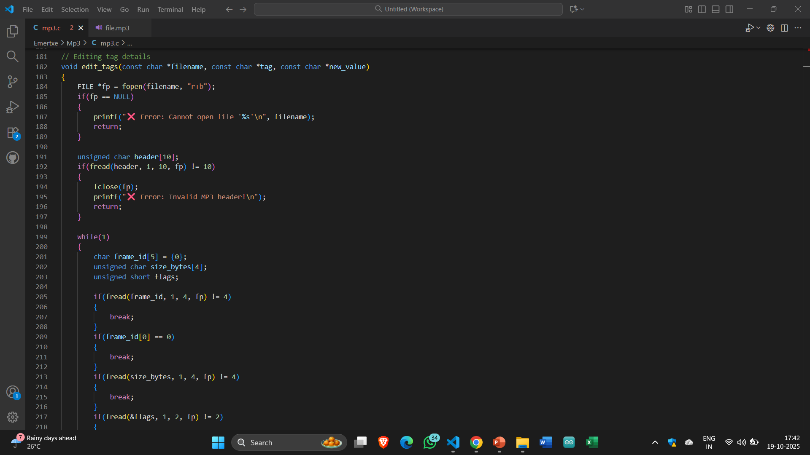
Editing tag details

Slide 11
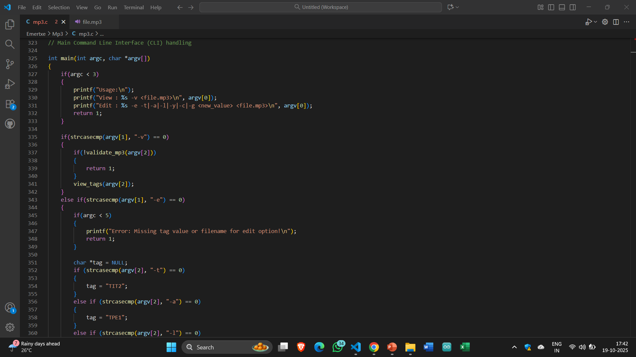
COMMand line Interface (CLI) handling

Slide 12
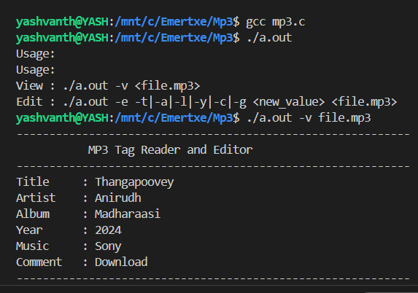
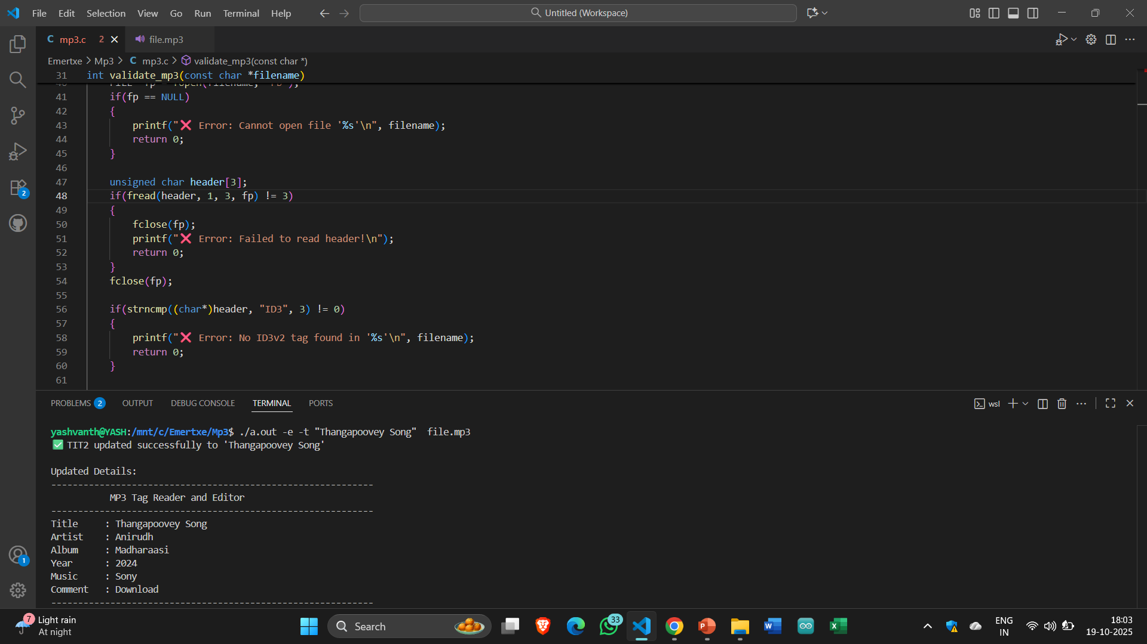




Overview of Song Details
Edited Title Name
Edited Artist Name
Edited Album Name
Edited Year
Edited Music & Comment

Slide 13
Core Takeaways
Enhanced C Fundamentals: Applied structures, arrays, and functions in a complete system.
File Handling Mastery: Learned to maintain real-time data using files for persistence.
Error Handling & Validation: Implemented checks for input accuracy and logical consistency.
Modular & Scalable Code: Designed the system for easy maintenance and future feature additions.
Practical Insight: Gained real-world exposure to system-level design and problem-solving in C.

